Slide 1

Vel Tech Rangarajan Dr. Sagunthala R&D Institute of Science and Technology
School of Computing
Department of Computer Science and Engineering
10211CS224 / FULL STACK APPLICATION DEVELOPMENT (JAVA)
END SEMESTER REVIEW
Date:06-05-2026
Smart Campus Event Management System
SDG: SDG No – SDG Title(Example: SDG 4 – Quality Education)
Presented By:
Sk.Mahammad Siraj – VTU26546– Reg.No.23UECS0880
Courses Handling Faculty: Dr.Hafizur Rahman Assistant Professor

Slide 2
INTRODUCTION
In modern campuses, managing events efficiently is a major challenge.
Students often miss important updates due to scattered communication.
This system provides a smart centralized platform for managing all campus events.
It allows students to explore, register, and track events easily.
Admins and organizers can manage events with automation and real-time updates.
The system improves communication and engagement across the campus.
It ensures all event-related information is accessible anytime.
This solution makes campus event handling more efficient and organized.
1
2
3
4
5
6
7
8
9

Slide 3
PROBLEM STATEMENT
1
2
Event information in campuses is often unorganized and delayed.
Students depend on notice boards, WhatsApp groups, or emails.
There is no unified platform for event registration and tracking.
Manual handling causes confusion and missed opportunities.
Organizers face difficulty in managing participants and updates.
Lack of real-time updates reduces participation.
A smart digital system is needed to solve these issues efficiently.
3
4
5
6
7
8
9

Slide 4
OBJECTIVE(S)
1
2
To develop a smart web-based campus event management system
To provide real-time updates and notifications
To simplify event registration and participation
To improve communication between students and organizers
To create a user-friendly and responsive interface
3
4
5
6
7
8
9

Slide 5
PROPOSED SYSTEM
A centralized web-based application to manage all campus events efficiently in one platform
Built using Spring Boot architecture to ensure scalability, performance, and maintainability
Secure login system with role-based access for Admin and Student users
Dynamic event management including creation, updates, and real-time event display
Admin can add, edit, and delete events while students can view and register for events
System securely stores event and registration data with proper backend processing
1
2
3
4
5
6
7
8
9

Slide 6
PROPOSED SYSTEM ARCHITECTURE
The system follows a three-tier architecture consisting of Presentation Layer, Application Layer, and Database Layer
It ensures smooth communication between user interface, backend logic, and data storage
Provides user interface for Admin and Students using HTML, CSS, and Thymeleaf
Displays event details, registration forms, and dashboards dynamically
Developed using Spring Boot to handle business logic and request processing
Uses Controllers and Services to manage event operations and user interactions
Implements authentication and authorization using Spring Security
Ensures secure login with role-based access control (Admin & Student)
Uses MySQL / H2 database to store event, user, and registration data
1
2
3
4
5
6
7
8
9

Slide 7
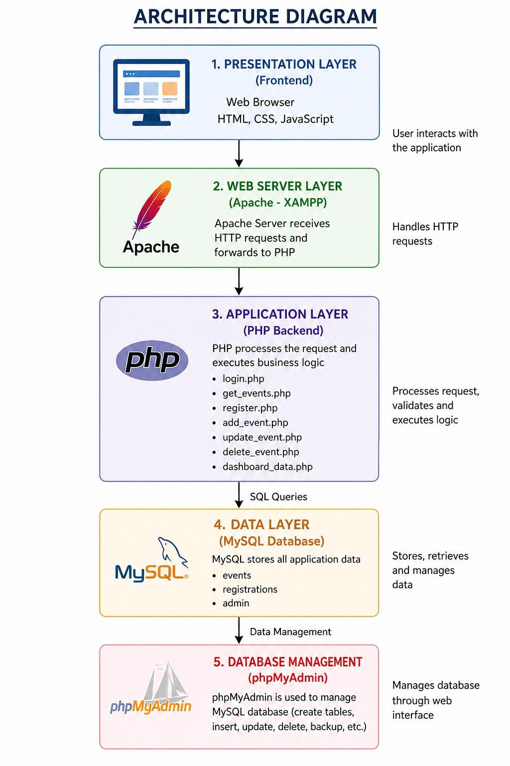
Architecture Diagram

Slide 8
WORKFLOW
1
User accesses the system through a web browser and logs in using valid credentials
The system authenticates the user and grants access based on role (Admin or Student)
Admin creates, updates, or deletes event details through the dashboard
Event data is stored and managed in the database
Students browse available events and view detailed information
Students register for selected events through the system
The system processes requests and displays updated event and registration information in real time
2
3
4
5
6
7
8
9

Slide 9
TECHNOLOGIES USED
Frontend Technologies
HTML – Used to design the structure of web pages such as login, dashboard, and event pages
CSS – Used for styling, layout design, and improving user interface appearance
JavaScript - Used to add interactivity and dynamic behavior to the application.
1
2
3
Backend Technologies
PHP – Used for server-side scripting, handling requests, and connecting frontend with database.
Apache (XAMPP) – Used as the web server to run the application locally.
4
5
6
Database
MySQL – Used to store event details, user registrations, and admin data.
phpMyAdmin – Used to manage the database through a graphical interface.
7
8
Tools & Development Environment
VS Code – Used for writing and managing code.
XAMPP – Used to run Apache server and MySQL database locally.
Web Browser – Used to run and test the application.
9

Slide 10
MODULE DESCRIPTION
User Authentication Module
Provides secure login functionality for both Admin and Student users Implements role-based access control using Spring Security Validates user credentials and prevents unauthorized access
Ensures secure session handling and authentication process
1
2
3
Event Management Module
Allows Admin to create new events with complete details (title, date, description) Enables updating and modifying existing event information
Supports deletion of events that are canceled or outdated
Maintains all event data in the database for easy access and management
4
5
6
Event Registration Module
Allows students to register for available events through a simple interface Stores participant details securely in the database
Helps organizers track the number of registrations
Simplifies the registration process compared to manual methods
7
8
9
Backend Processing Module
Handles all client requests using Spring Boot controllers Processes business logic through service layer components Validates input data before storing or processing
Ensures smooth communication between frontend and database

Slide 11
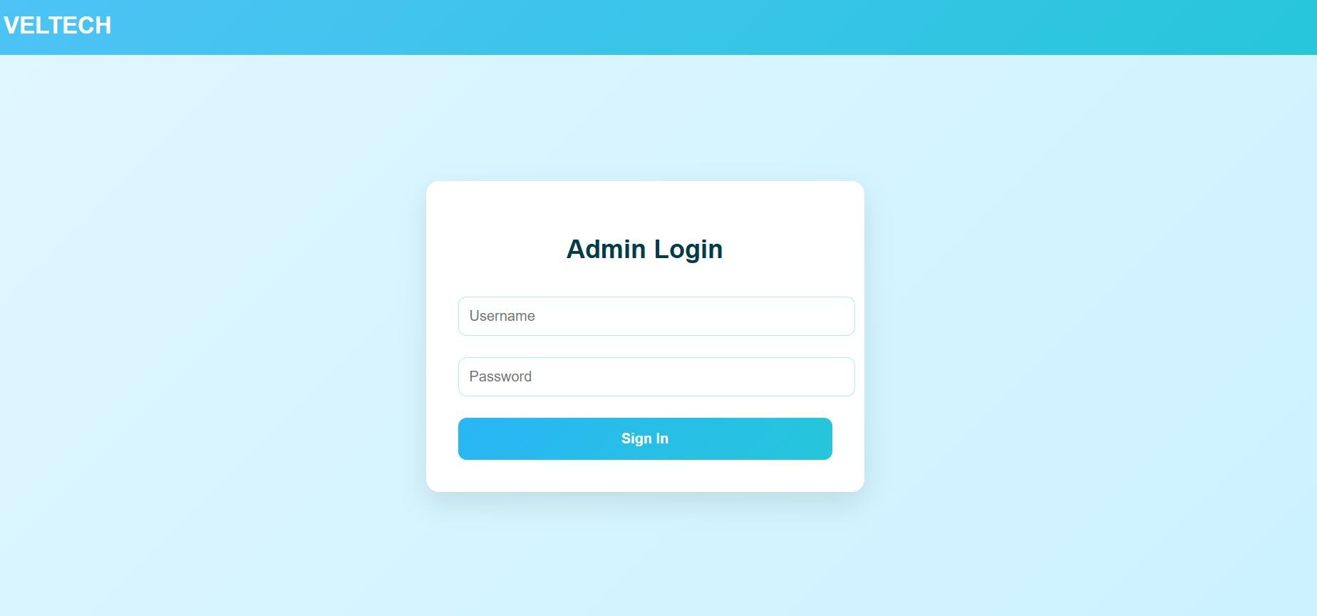
IMPLEMENTATION SCREENSHOTS
1
2
3
4
5
6
7
8(A)
9

Slide 12
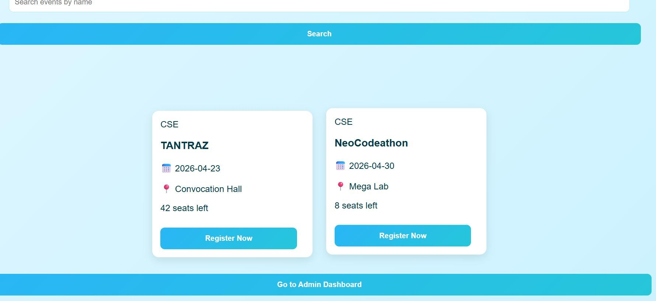
IMPLEMENTATION SCREENSHOTS
1
2
3
4
5
6
7
8
9

Slide 13
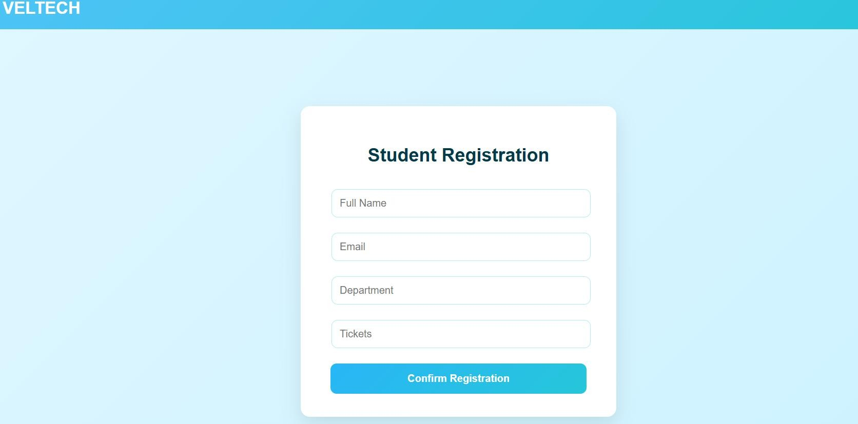
IMPLEMENTATION SCREENSHOTS
1
2
3
4
5
6
7
8(B)
9

Slide 14
ADVANTAGES & LIMITATIONS
ADVANTAGES
1
Provides a centralized platform to manage all campus events in one place
Reduces dependency on manual methods like notice boards and messages
Ensures real-time access to event updates and information
Improves communication between students and event organizers
Simplifies event registration process through an online system
Enhances student participation by making events easily accessible
2
3
4
5
6
7
8
LIMITATIONS
Requires stable internet connection to access the system
Basic user interface may not be highly interactive or modern
Limited to web platform (no mobile application support)
Notification system (email/SMS) not fully implemented
9

Slide 15
Thank you

